Slide 1

Chat botck
Graduation Project 2023-2024

Slide 2

Supervied By:
Dr.Rodaina Abdelsalam
Eng. Aya Magdy

Slide 3
Team Member
01
02
03
04
Philopater Shenouda
20-00578
Mohamed Ahmed
20-00145
Shaker Emad
20-00336
Mohamed AlFaramawy
20-00660
05
06
07
Abdulrahman Zakaria
20-01613
Ibrahim Abdeltawab
20-01508
Khald Ashraf
20-01975

Slide 4
Abstract
This project introduces a specialized e-commerce platform for selling laptops, featuring an intelligent Chabot.
Additionally, users can explore and purchase laptops along with exclusive accessories through the user-friendly online store interface, enhancing the overall shopping experience.
Leveraging artificial intelligence, the project ensures accurate and personalized recommendations for both laptops and associated accessories.

Slide 5
Outline
Introduction
Problem Statement
Related Work
Methodology of Proposed Approach
Research Objectives
Time Plan
Conclusion
Future Work
References

Slide 6
01
Introduction

Slide 7

Introduction
This project offers an innovative platform for purchasing laptops, featuring a chat bot that provides personalized recommendations to users of all knowledge levels. The site combines ease of use, cutting-edge technology and personalized assistance, simplifying the laptop selection process. The platform aims to create an enjoyable journey for the user in finding the right device.

Slide 8
02
Problem Statement

Slide 9

Problem Statement
The primary objective is to offer a solution for individuals within this group who find it challenging to navigate the laptop selection process. Through the development of an easy-to-use platform equipped with an intelligent chat bot, our project seeks to empower users with limited experience in choosing laptops.

Slide 10
03
Related Work

Slide 11
Paper 1
A Comprehensive Analysis of Recommendation System for ECommerce Mobile App using various Algorithms
2021
Collaborative , Content-based and K-means
E-commerce websites use recommendation systems to suggest products to customers, based on their browsing history and other data, to increase sales and offer personalized deals. This paper explores how these systems work

Slide 12
Paper 2
Content Based Movie Recommendation System
2020
Content Based
This research proposes a movie recommendation system using a single score combining cast, keywords, crew, and genres to suggest movies users might enjoy, aiming to save them browsing time and cater to their preferences based on previously liked movies

Slide 13
Paper 3
Recommender System in eLearning: A Survey
2020
Content Based and Collaborative-filter and K-Means
This research proposes an "e-learning task recommender" system using user profiles and access patterns to suggest relevant learning tasks to students, addressing the issue of finding appropriate learning content amidst vast resources.

Slide 14
Paper 4
Implementation K-Means Clustering Method in Job Recommendation System
2021
K-Means Clustering
This research proposes a K-Means Clustering-based job recommendation system for fresh graduates, matching them to suitable vacancies based on skills, salary, and location

Slide 15
RELATED WORK
Some features are NOT found in Model:
Chat botck | Amazon
Our site features a smart chatbot that provides personalized guidance to users in selecting the right laptop. | Amazon may have chat support, but they may not offer a similar level of personalized guidance.
We have a specific focus on the laptop category, meaning we provide tailored recommendations and carefully curated products in this field. | Amazon covers a wide range of products and categories, which may make the specific focus on laptops less prominent

Slide 16
RELATED WORK
Some features are NOT found in Model:
Chat botck | B.TECH
Our website prioritizes simplifying the laptop selection process and overall shopping experience, offering a seamless experience for users.. | B-tech interface may be more complex due to the diversity of products and services they offer..
Our site provides comprehensive specifications and comparison tools for laptops.. | B-tech may not have as detailed specifications or specialized comparison tools for laptops.

Slide 17
04
Methodology of Proposed Approach 1-ML 2-Web app

Slide 18
Recommendation System
Content-Based Filtering
K-Means

Slide 19

Used algorithm
Content-based
K-means

Slide 20
Content-Based Filtering
Content-based recommendation relies on product content and user preferences
Similarity are used to measure the resemblance between product content and user preferences
One challenge faced was the extended processing time due to measuring similarity between user preferences and all products in the database.
To address the time issue, we implemented the K-means algorithm.

Slide 21
Content-Based Filtering
User Profile Creation
Profile Preferences
User
Processing
Similarity Calculation
Processing
Extracting Information
Items
Dataset
Weighted Similarity
Recommendation Display
Print
Top Matches
Selection

Slide 22
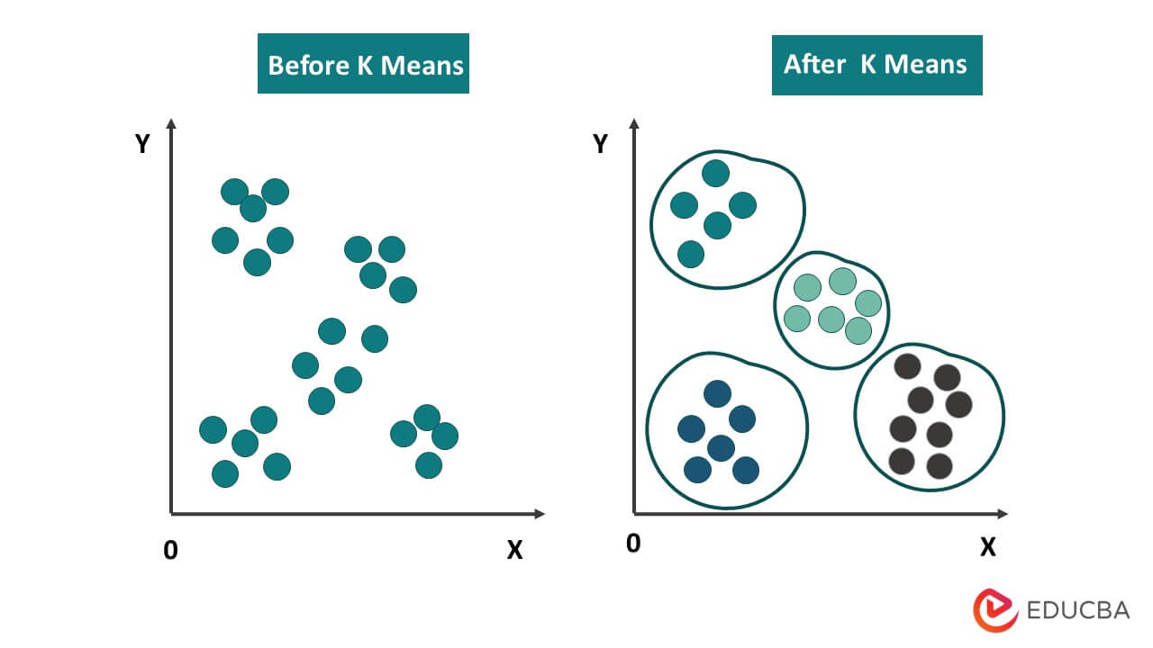
K-means
K-means helps cluster products based on similarity
By grouping products with similar feature, , leading to faster recommendation generation and enhancing overall system performance.

Slide 23
Model explanation
1. Data Preparation:
• Importing the necessary libraries and reading the data from a CSV file
• Identifying the features and the target variable for training and removing missing values.
2. Applying K-means Clustering:
• Using the K-means algorithm to cluster the processed data.
• Determining the number of clusters and applying the algorithm to the processed features.
3. User Profile Extraction and Directing to the Appropriate Cluster :
• Users specify their preferences, including price and desired device specifications.
• Direct users to the cluster aligning with their preferences using the K-means algorithm.
• This facilitates personalized recommendations by selecting clusters with devices matching the user's preferences.

Slide 24
Model explanation
4. Content-Based Recommendation within the Cluster:
• Implement a content-based recommendation system within the chosen cluster.
• Identify suitable devices by presenting those matching the user's preferences within the cluster.
5. Presenting Recommendations:
• After identifying suitable devices, present a list of 5-recommendations to the user. • Additional information like price and ratings can assist in the decision-making process.

Slide 25
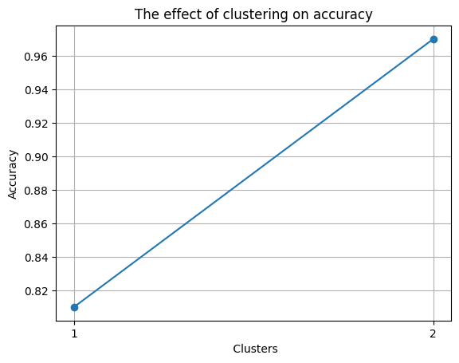


Accuracy
After clustering the data, there was a notable improvement in model accuracy, enabling more efficient analysis with reduced dataset size
enhancing both performance and prediction.

Slide 26
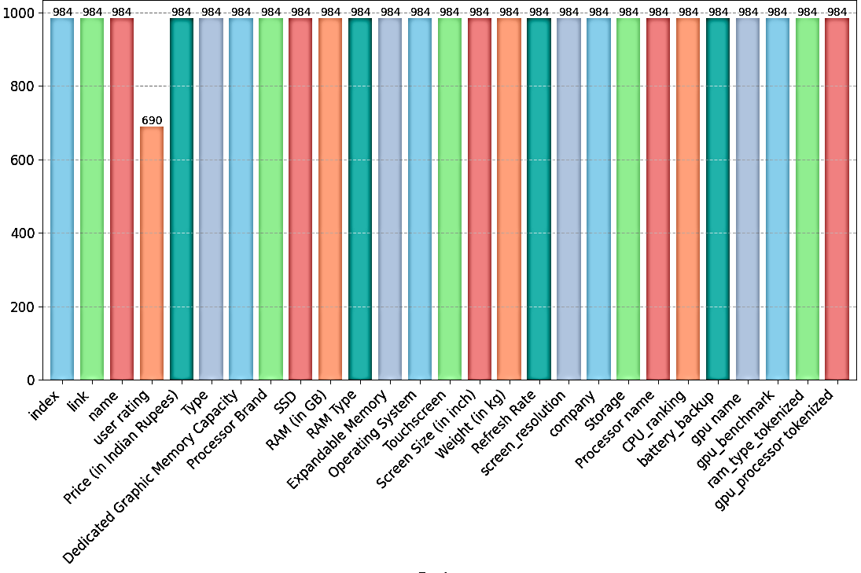
Dataset
The dataset is the laptop listings an ecommerce website in India corresponding laptop's CPU ranking and GPU benchmarks. The dataset has 26 features (Ex: Laptop name, link to buy, price in Indian rupees, processor, GPU, processor ranking, GPU benchmark, etc.)

Slide 27
Methodology Of Web
Front end
Back end
Figma
Html
Css
Booststrap
JS
Php
My -Sql

Slide 28
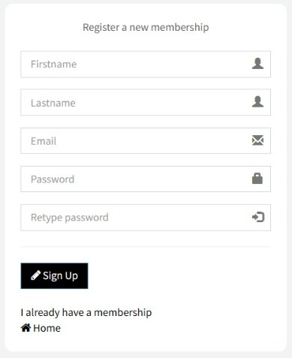

Slide 29
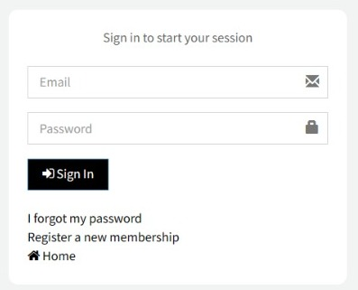

Slide 30
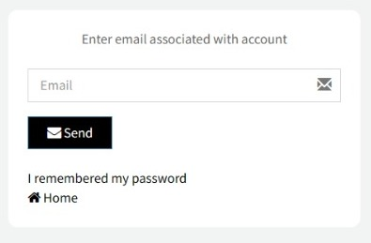

Slide 31
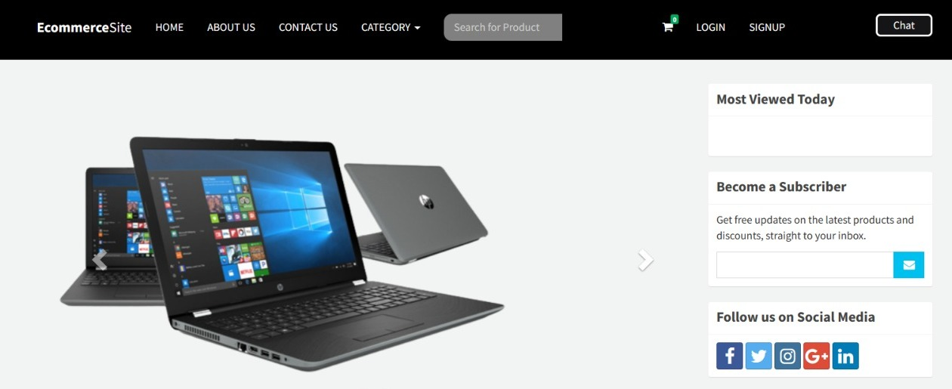

Slide 32
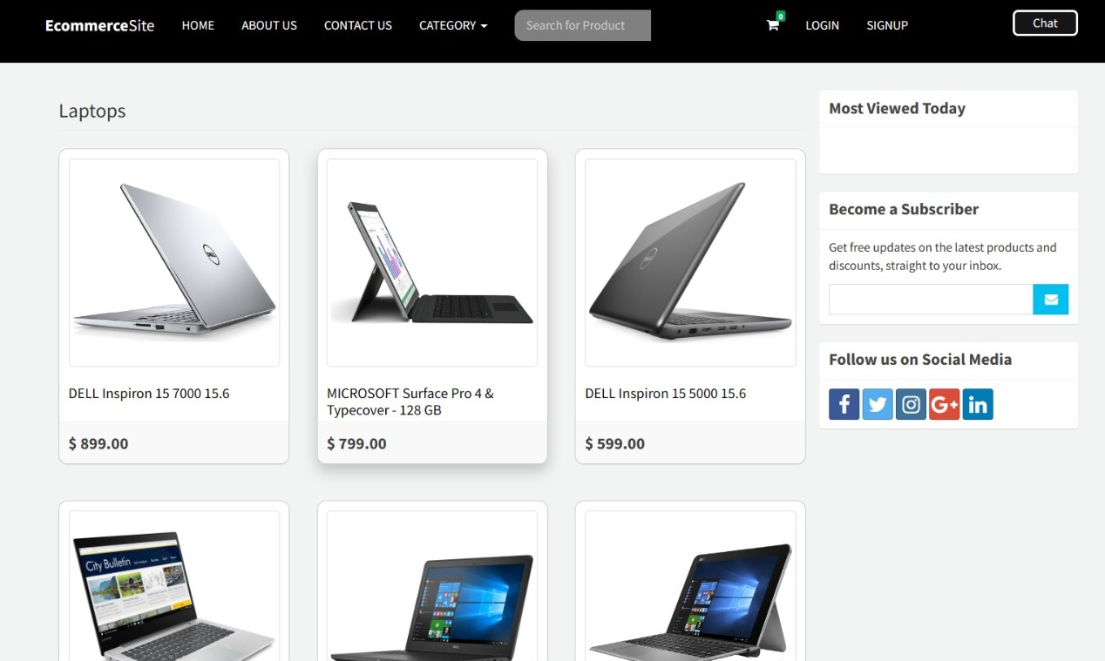

Slide 33
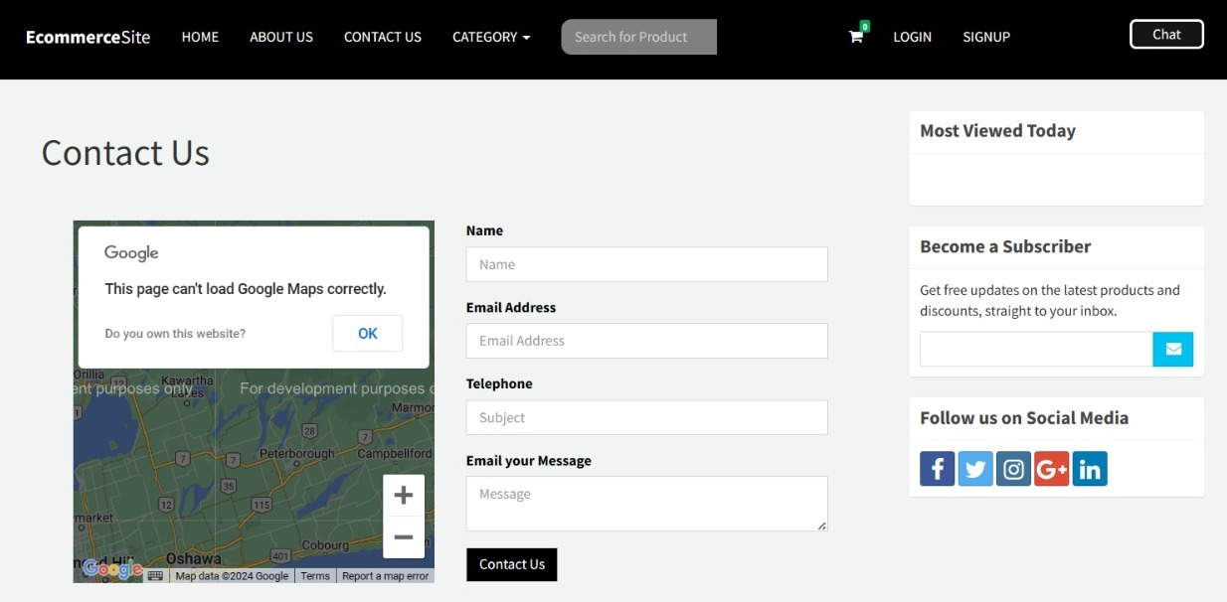

Slide 34
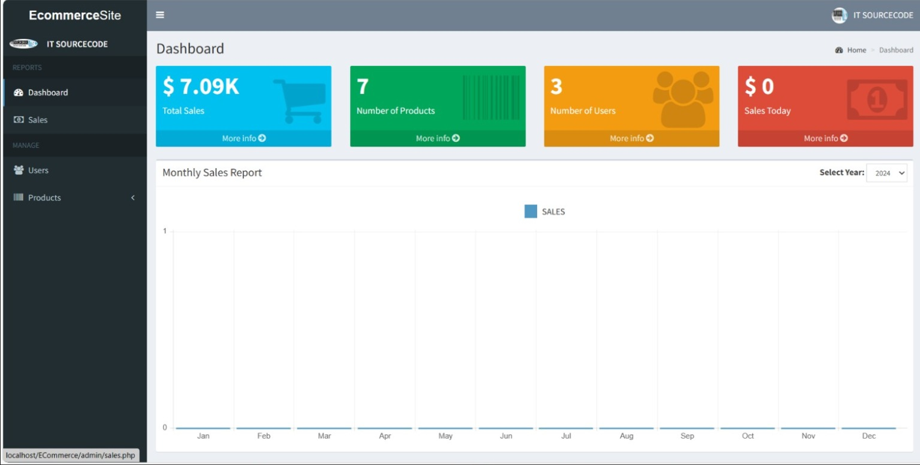

Slide 35
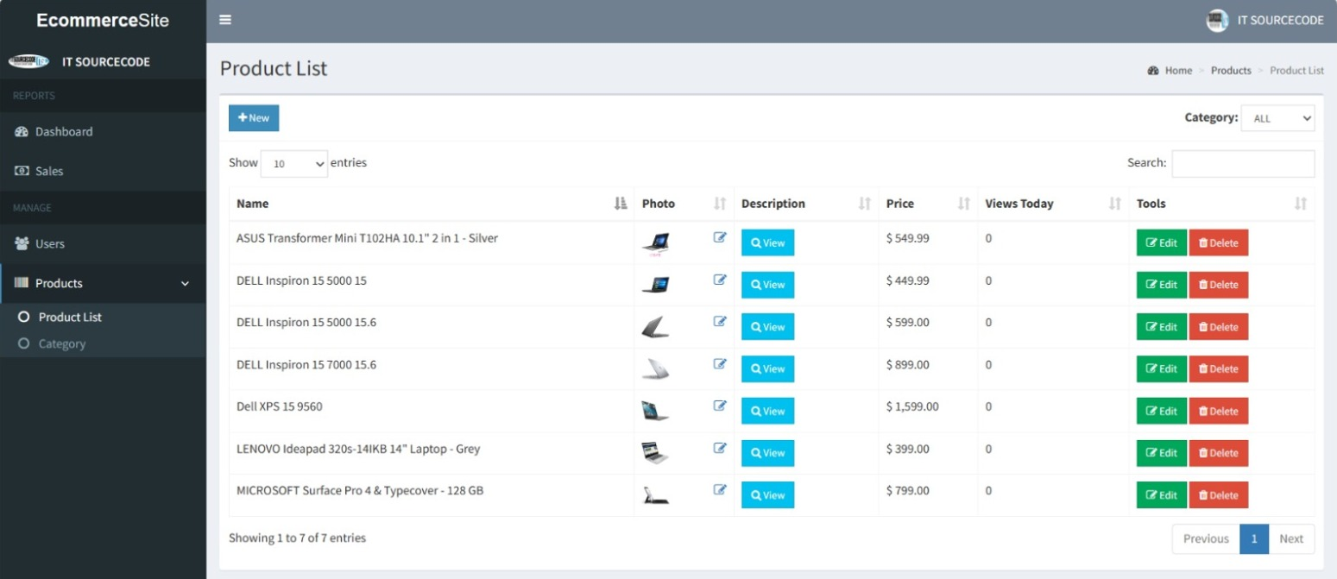

Slide 36
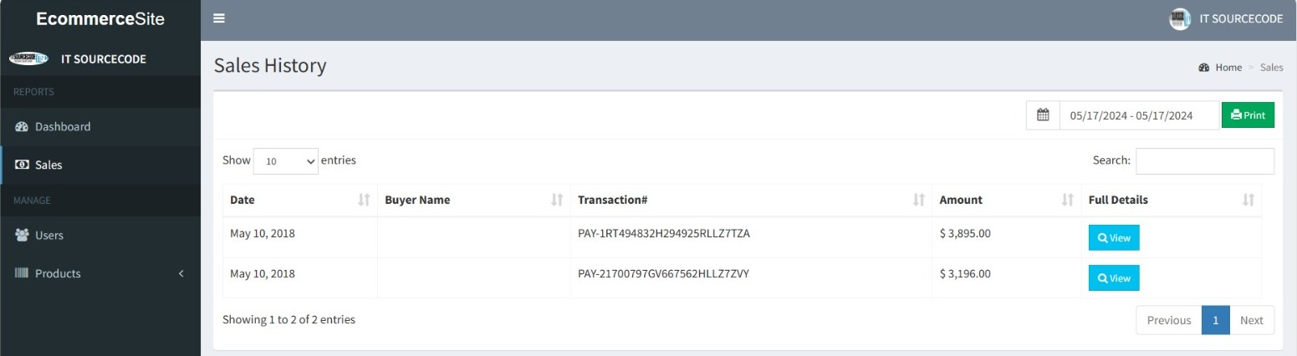

Slide 37
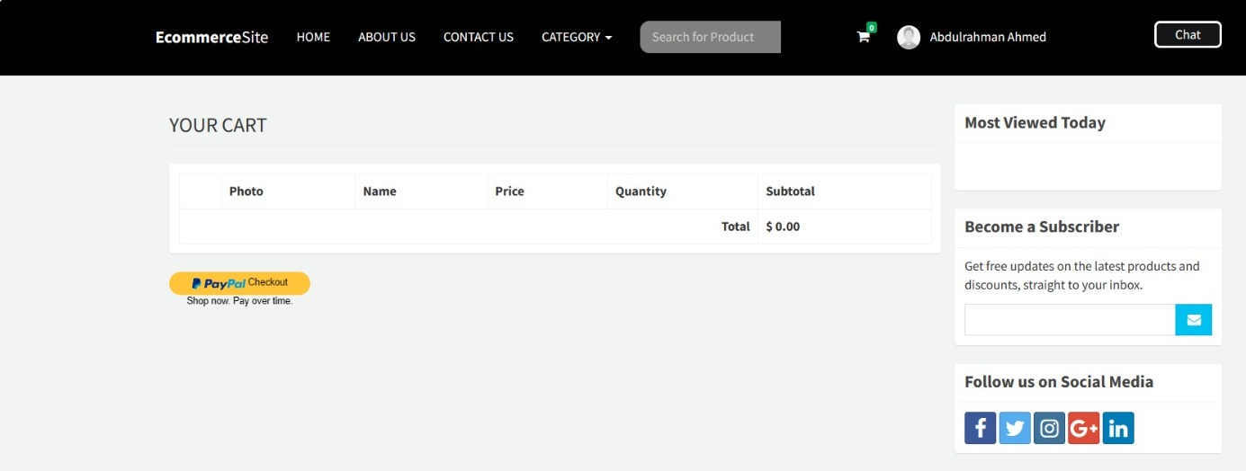

Slide 38
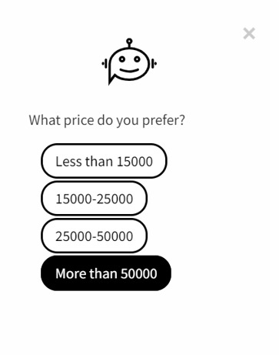
Any Questions?

Slide 39
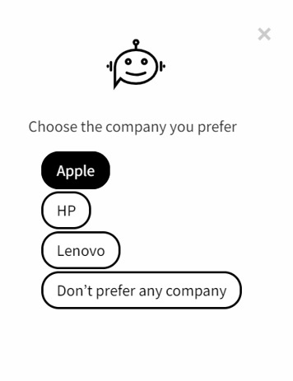
Any Questions?

Slide 40
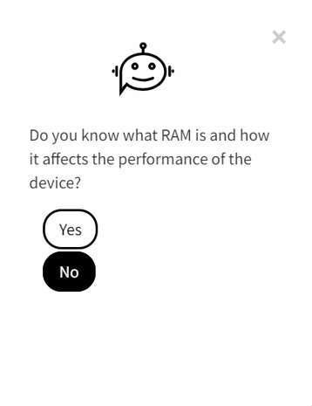
Any Questions?

Slide 41
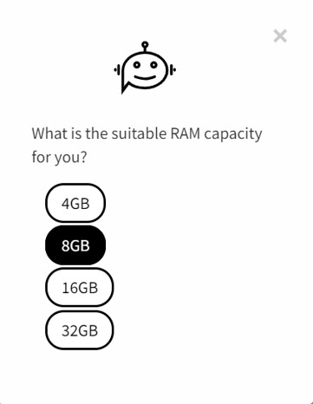
Any Questions?

Slide 42
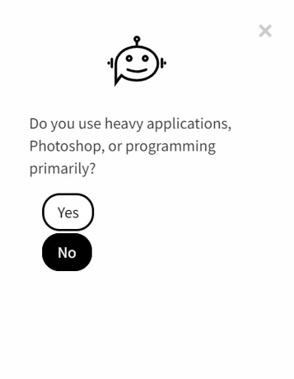
Any Questions?

Slide 43
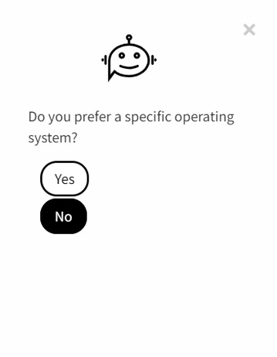
Any Questions?

Slide 44
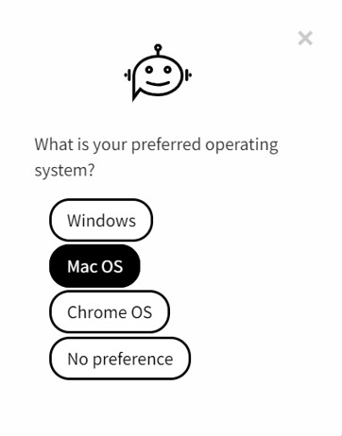
Any Questions?

Slide 45
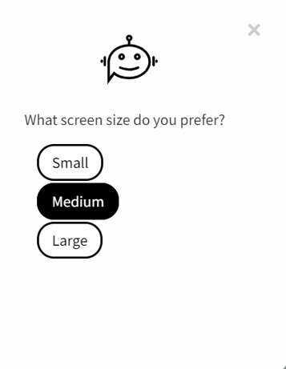
Any Questions?

Slide 46
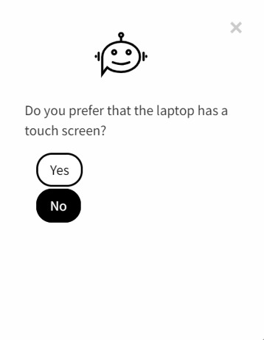
Any Questions?

Slide 47
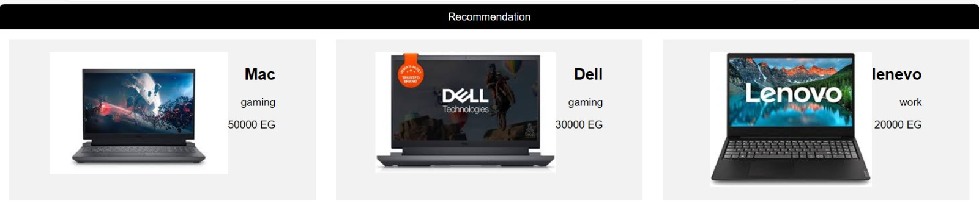

Slide 48
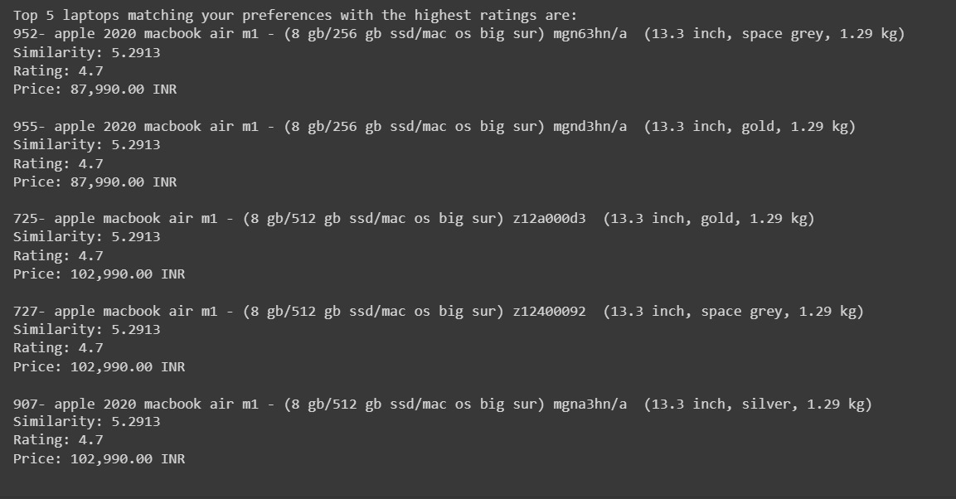
Output

Slide 49
05
Research Objectives

Slide 50
Research Objectives:
The research project endeavors to create a chatbot designed to assist users with limited knowledge of laptop capabilities. Its primary objective is to recommend suitable laptops tailored to individual needs, streamlining the shopping process for those unfamiliar with technical specifications. By offering personalized guidance, the chatbot aims to enhance the overall user experience and simplify the decision-making process when selecting laptops.

Slide 51
06
Time Plan

Slide 52


Nov
Dec
Nov
Apr
Jan
Feb
Mar
May
Idea generation
Research
Prototype
Model
Website

Slide 53
07
Conclusion

Slide 54
Conclusion
This project introduces a specialized e-commerce platform for selling laptops, featuring an intelligent chatbot. The chatbot engages users with personalized questions, providing customized laptop recommendations based on preferences. Additionally, users can explore and purchase laptops along with exclusive accessories through the user-friendly online store interface, enhancing the overall shopping experience. Leveraging artificial intelligence, the project ensures accurate and personalized recommendations for both laptops and associated accessories.

Slide 55
08
Future Work

Slide 56

Future Work
Model Enhancement:
User Feedback Mechanism:
Integrate Collaborative Filtering techniques based on user interactions
to refine content suggestions.
Develop a robust feedback mechanism to capture user satisfaction and areas for improvement directly from the users.
User Interface Development and Website Design:
Improving Data Security and User Privacy
Elevate user experience to build mobile app
Strengthen data security and user confidentiality.

Slide 57
09
References

Slide 58


References
Roy, Parth, et al. "A Comprehensive Analysis of Recommendation System for E-Commerce Mobile App using various Algorithms." (2021).
Pradeep, N. K. K. R., et al. "Content based movie recommendation system." International journal of research in industrial engineering 9.4 (2020): 337-348.
Kulkarni, Pradnya V., Sunil Rai, and Rohini Kale. "Recommender system in elearning: a survey." Proceeding of International Conference on Computational Science and Applications: ICCSA 2019. Singapore: Springer Singapore, 2020.
Puspasari, Betty Dewi, et al. "Implementation K-Means clustering method in job recommendation system." 2021 7th International Conference on Electrical, Electronics and Information Engineering (ICEEIE). IEEE, 2021.

Slide 59

Any Questions?

